Slide 1
DDOS Detection using Spark
How to get started with real-time detection of DDOS Attack using Spark

Slide 2

Objective
Collect log data in real-time
Store all the record for further analysis
Process those log in real-time to find the anomaly and DDoS attack

Slide 3
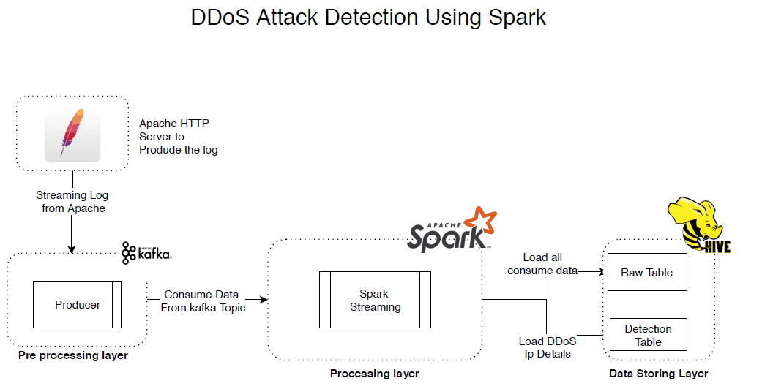
Architecture Diagram

Slide 4
Current State
Pre Processing
Generate log from Apache server on every hit by client IP address.
Kafka producer collect that log and push it into the assigned topic
Processing
On processing layer spark collect the log data from Kafka topic on every two min micro batch window.
Process the data and check on the IP address, to find maximum hit.
Storage
Once we get the processed data from spark after every 2 min, we store it as a CSV file for further analysis

Slide 5
Feature State
Server Log, Pre processing layer
Apache Kafka collect log in real-time, and push it into Kafka topic
Do a time-series analysis on top of apache spark, to validate log
Store data into hive for further analysis
Apache Spark collect all the log from Kafka topic on 30 sec micro batch.

